Slide 1
Praktikum: Cloud Data Bases (IN0012, IN2106, IN4163)
by Aly Kamel, Iremur Kidil, Ricardo Kraft
28.01.2020

Slide 2
Overview
Motivation
Use case scenario
Demands of the client
Our solution
Implementation
Perfomance Tests
Conclusion
References

Slide 3

I. Motivation
A. Redis – Pub/Sub
TOPIC
Publisher
(Sender)
Subscribe
Subscriber N
(Receiver)
Publish
Receive

Slide 4
I. Motivation
B. Group chat
CHAT ROOM
Client N
Sends
Sends
Client N
Receives
Receives
4

Slide 5
I. Motivation
C. 1:N vs. N:N
1 : N
N : N

Slide 6


II. Use Case Scenario
Cookie Factory

Slide 7
Cookie Factory
Global-Chat
NEW YORK
MUNICH
NYC MANAGER
MUC MANAGER
NYC-Chat
MUC-Chat
Brooklyn
Queens
Bronx
Garching
Pasing
Laim

Slide 8





III. Demands of the client
Saving the chat history
Unique usernames
Access database while in the chatroom
Password protected private chatrooms
Public chatrooms
8

Slide 9

IV. Our solution

Slide 10
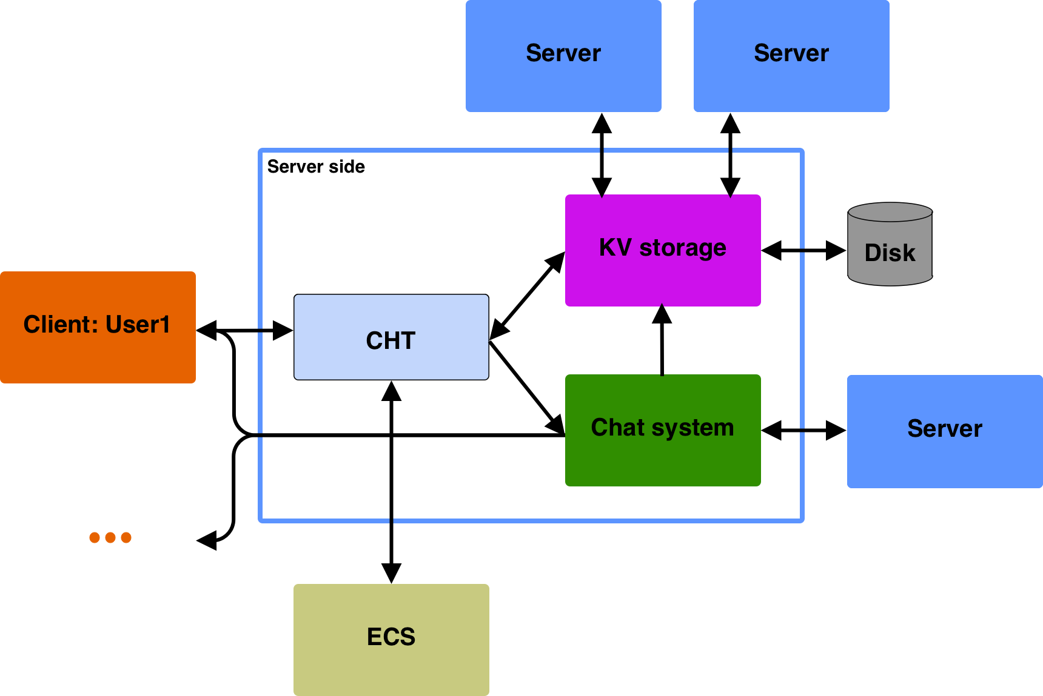

Slide 11
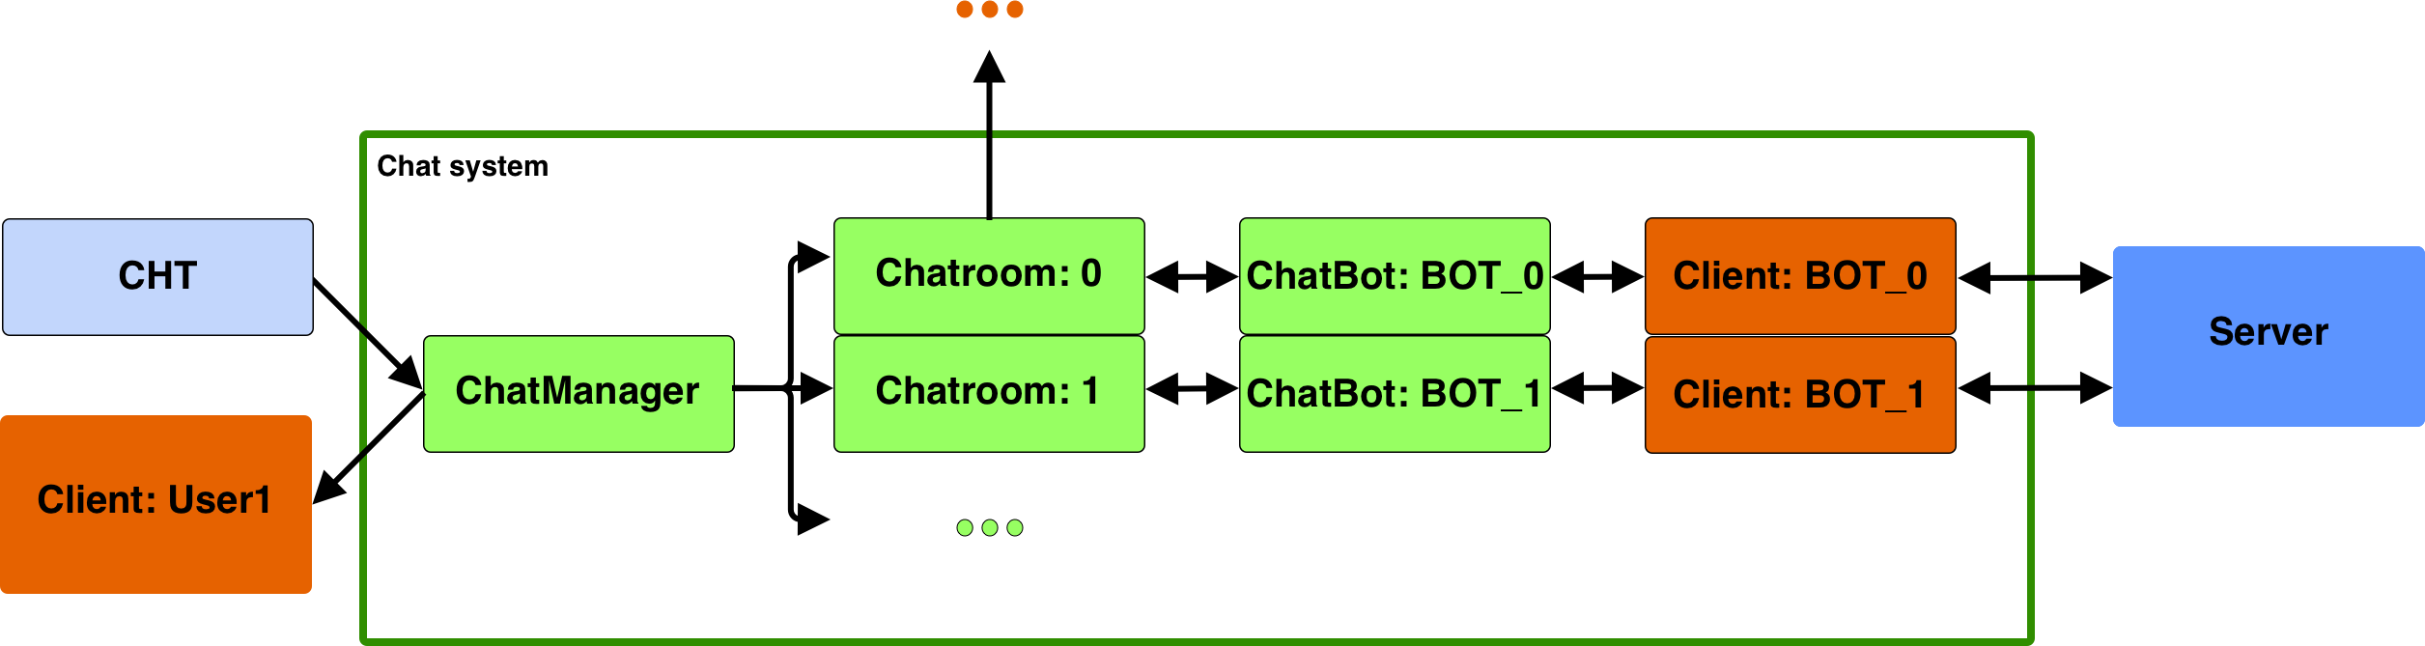

Slide 12





V. Implementation
A. Our steps
Create and join public chatrooms
Make them globally unique
Save the chat history
Write in the chat
Send notifications of joining and leaving users
Have a username

Slide 13

V. Implementation
B. Availability problem
Connecting to a chatroom uses the one and only socket of the client.
How do we access the database while being in the chatroom?
Increase the socket size? No, that would increase network traffic.
Exit the chatroom and rejoin quickly? No, we miss messages.
What do we do then?
The ChatBot.

Slide 14
V. Implementation
C. ChatBot
GarchBoss: Hey! I want to update my order, because I ran out of cookies.
GarchBoss: PUT garchingOrder “3000 chocolate chip, 1500 apple cinnamon, 7000 white chocolate“
MucManager: GET{garchingOrder}
MucManager: Only problem, I only have 4500 of white chocolate this week.

Slide 15
Key-value server
V. Implementation
D. Message handling
User1: I have GET{n} coins.
n
5
ChatManager
User1: I have GET{n} coins.
ChatRoom
ChatBot
I have GET{n} coins.
User1: I have 5 coins.
User1: I have 5 coins.
User1
Clients in the chatroom

Slide 16
V. Implementation
D. More Commands
ACTIVE
Returns a list of all users in the chatroom.
WSP <user1>,<user2>,…,<userN>
Sends a whisper to provided clients.

Slide 17
V. Implementation
F. Private chatrooms
Password protected chatrooms for e.g. filtering the regions
NEW YORK
NYC MANAGER
NYC-Chat
Brooklyn
Queens
Bronx

Slide 18
VI. Performance evaluaiton
A. Constants
320 keys from the EnronSet
Operation order: puts, gets, deletes on all keys
Key order randomized
Cache replacement strategy: LRU
Cache size: 16 (5% of 320)

Slide 19
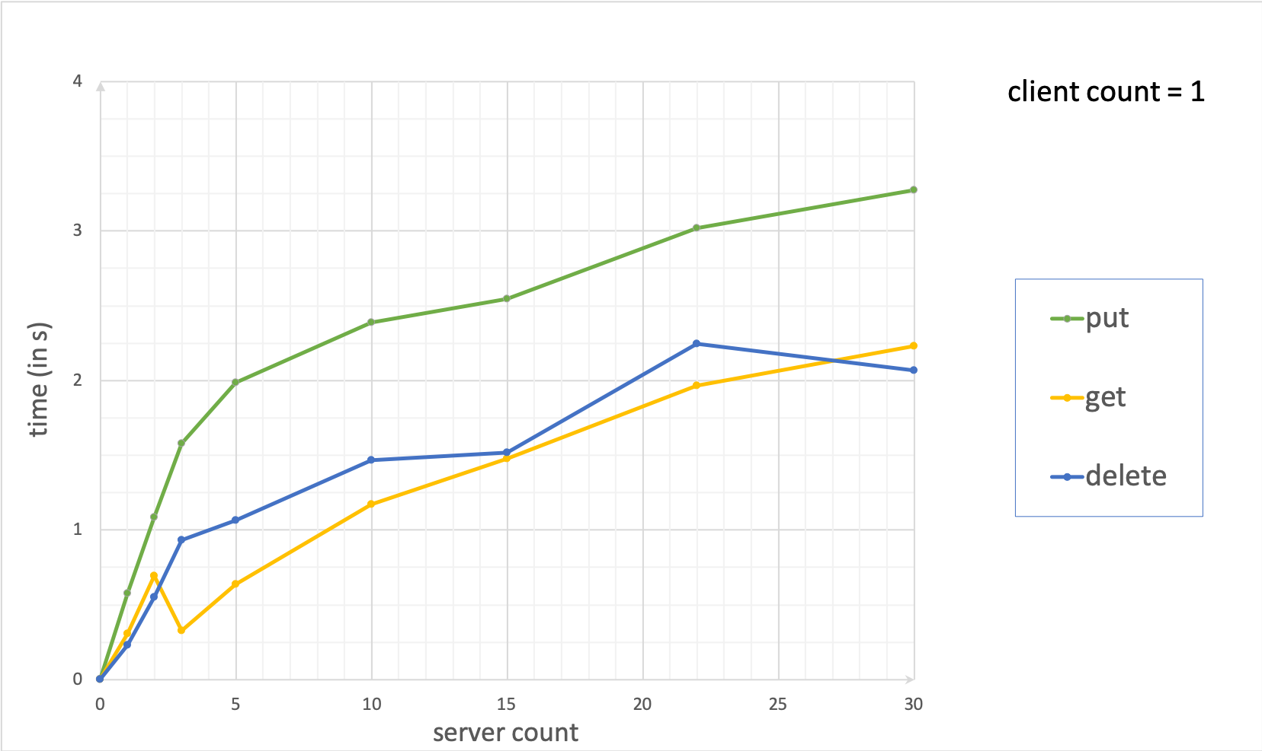

Slide 20
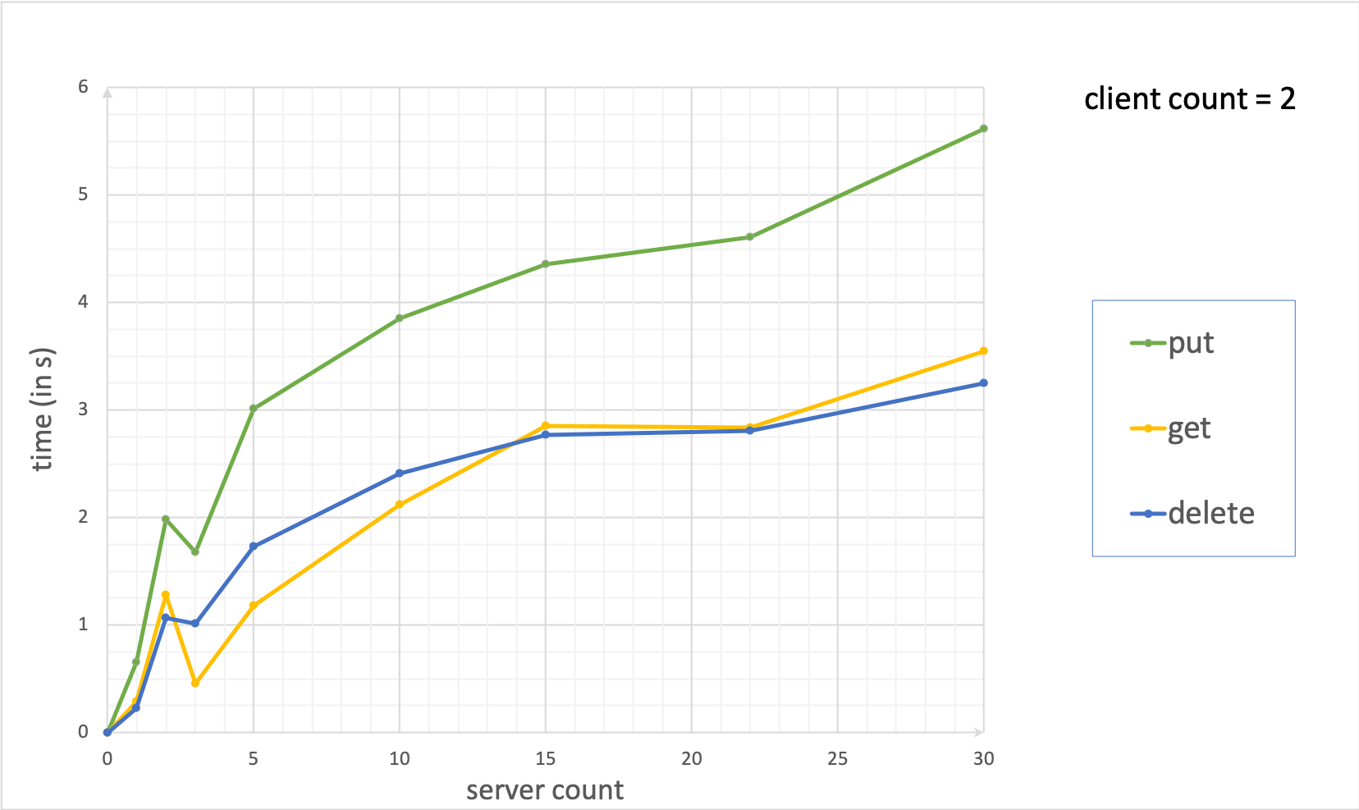

Slide 21
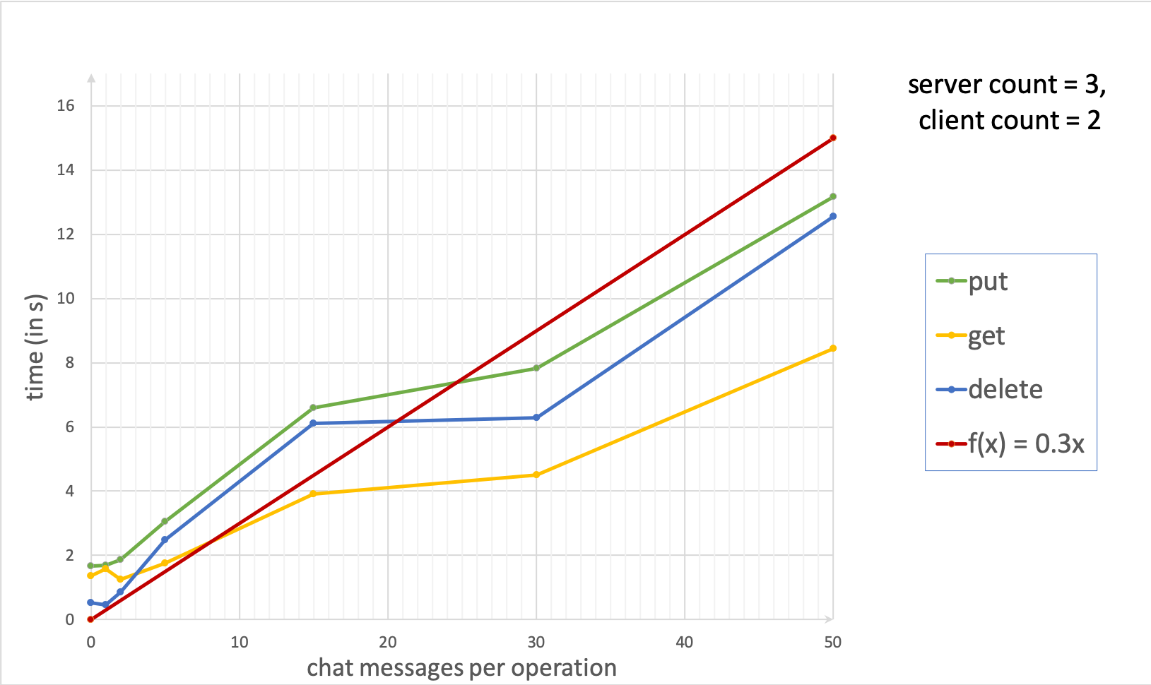

Slide 22
VII. Conclusion
Pros
Light-weighted communication
Acces to database while chatting
1 socket per client (good for network)
Cons
Limited number of chatrooms
Limited number of clients

Slide 23
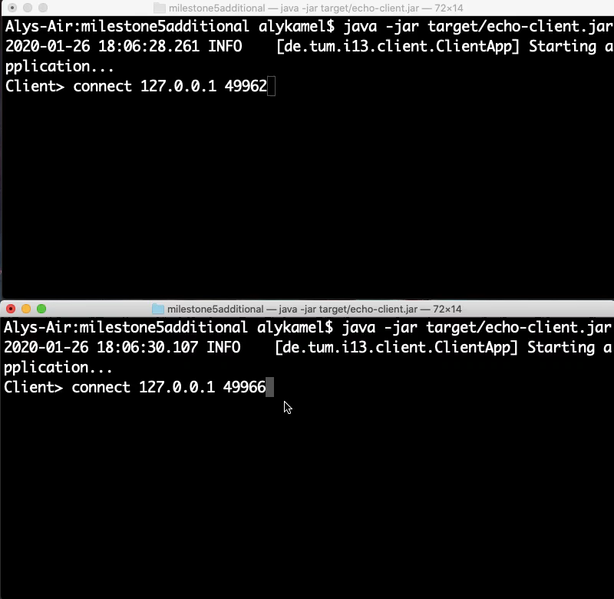
VIII. Demonstration

Slide 24
THANK YOU FOR YOUR ATTENTION!

Slide 25
IX. References

